Slide 1
Accuracy and Reoperation Rate for Cortical Bone Trajectory Screws
Utilizing the Cannulator Technique
Nitin Khanna, MD
Michael Krzyskowski, PA-C
Matthew Udani, B.A.

Slide 2
Introduction
There has been an increased utilization of Cortical Bone Trajectory (CBT) screws in treatment of Lumbar Degenerative Spinal pathology.
  Easier ergonomics for screw placement
  Ability to capture the middle column of the spine utilizing a minimally invasive single incision midline exposure.
Novel “inside-out” trajectory and starting point identification is a barrier to widespread adaptation.
  Early techniques were clumsy utilizing multiple passes with burrs, hand drills, awls, and taps.
The cannulator technique combines multiple instruments into one instrument and utilizes a slightly more lateral starting point to allow for more reproducible screw placement with minimal steps.

Slide 3
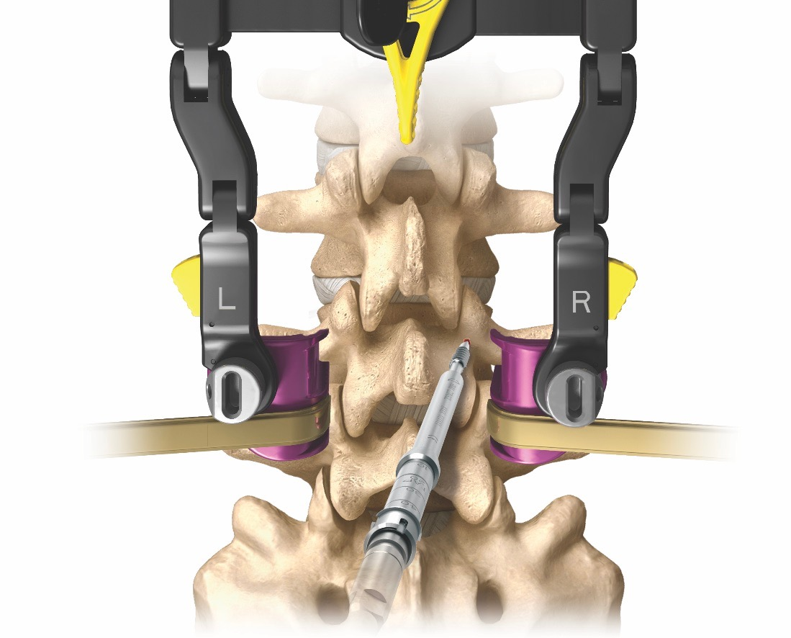
Introduction
Novel “inside-out” trajectory and starting point identification is a barrier to widespread adaptation.
Early techniques were clumsy utilizing multiple passes with burrs, hand drills, awls, and taps.

Slide 4
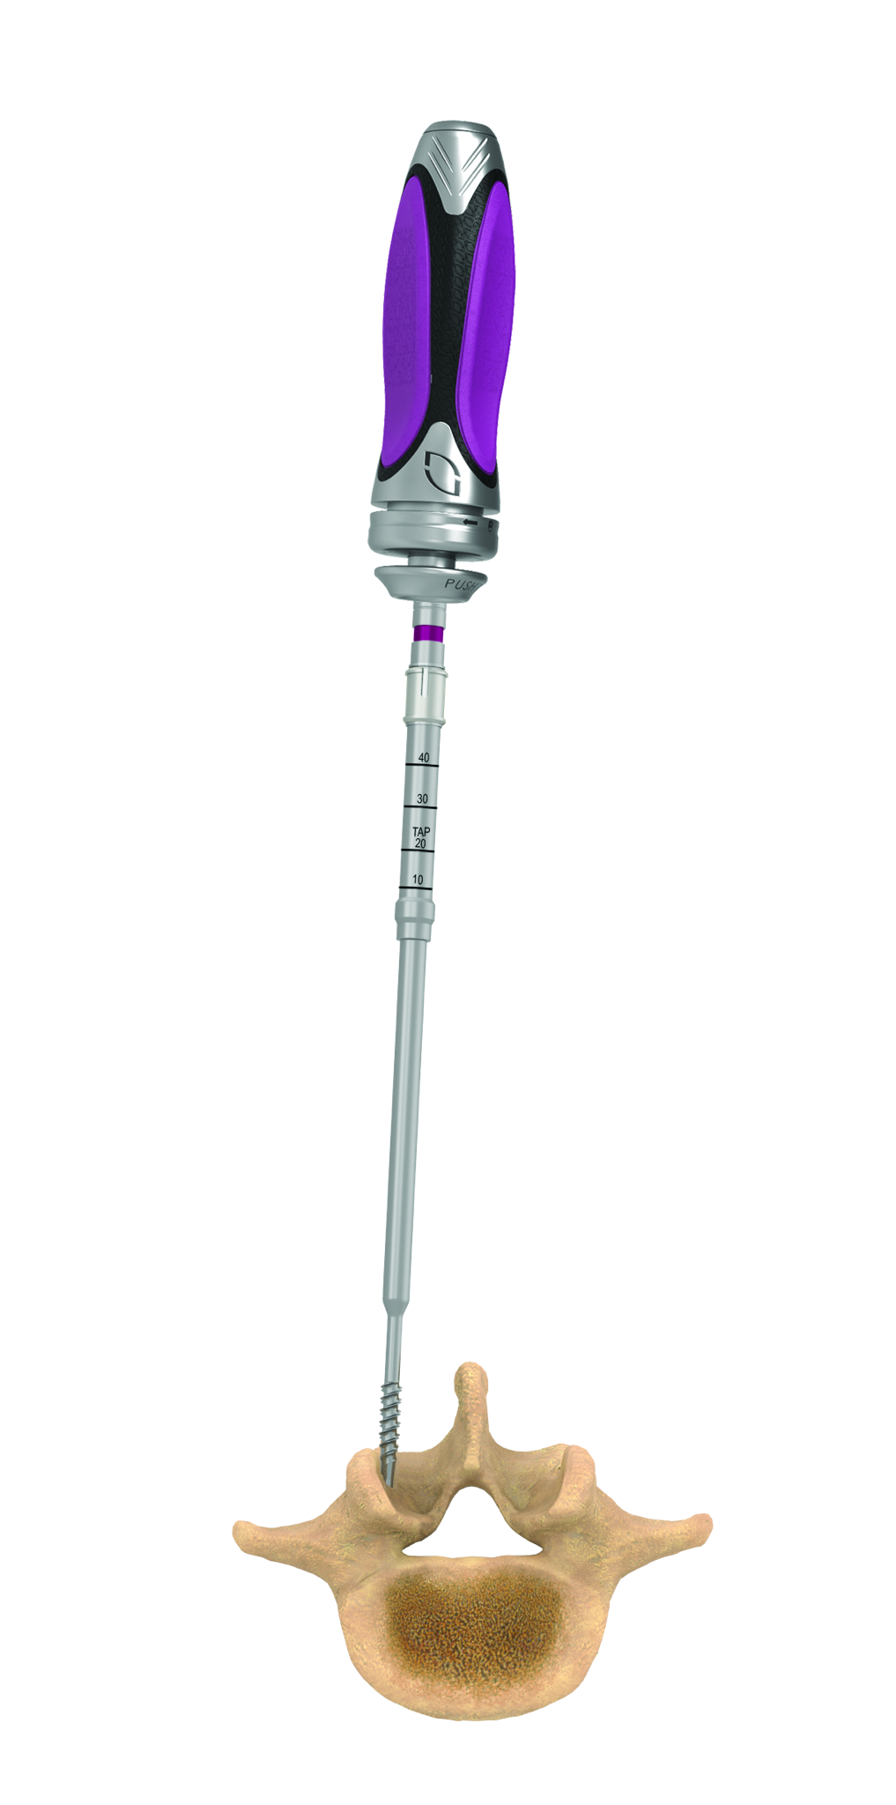
Introduction
The cannulator technique combines multiple instruments into one instrument and utilizes a slightly more lateral starting point to allow for more reproducible screw placement with minimal steps.

Slide 5
Materials/Methods
A retrospective chart review was performed to identify all posterior lumbar fusion patients from January 1, 2014 through July 27, 2020
Once identified, postoperative plain radiographs were reviewed to obtain an accurate number of total posterior lumbar screws placed.
Operative and office visit notes were then reviewed to determine the number of screws requiring repositioning after surgery.
A screw revision rate was determined by dividing the total number of screws repositioned by the total number of screws placed.

Slide 6
Results
Between January 1, 2014 and July 27th, 2020 1503 total posterior lumbar screws were placed
5 patients returned to surgery for repositioning.
In one case, the bilateral L4 screws were repositioned.
2 patients required a repositioned left L5 screw.
One patient required a repositioned left L4 screw and one required the right L4 screw.
All screws repositioned were due to medial breaches.
Only symptomatic patients received postoperative CT scans to verify screw placement.
6 total screws revised = 0.39% screw revision rate

Slide 7
Discussion
Several studies have examined the placement of freehand standard trajectory pedicle screws compared with robotic navigated placement.
This is the first paper that has investigated revision rates for mispositioned cortical trajectory screws.
The modifications to both the technique and instrumentation are key to producing an extremely low revision/reoperation rate.
The main weakness of this study is the lack of routine CT scans to determine the exact positioning of each cortical screw placed.
  Only symptomatic patients obtained CT scans to verify screw placement

